Slide 1
MMDAgent

Slide 2
Agenda
Brief Introduction of MMDAgent
History
Current status

Slide 3
Background and Motivation

Slide 4
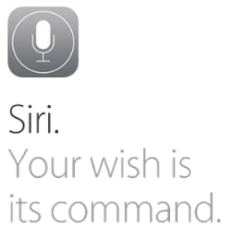

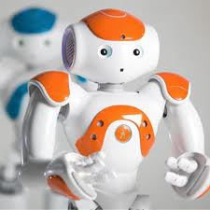
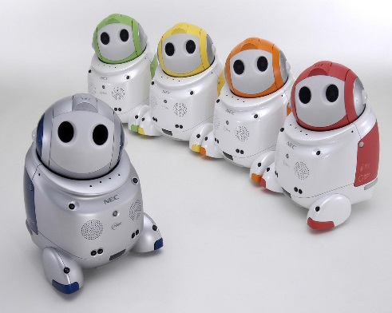
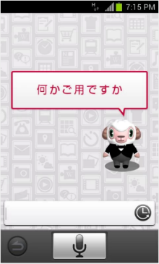
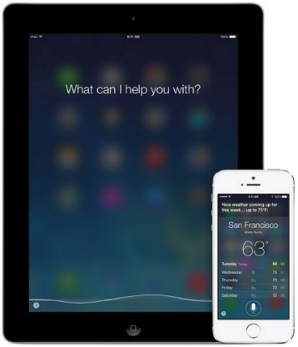

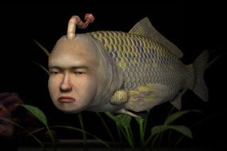
Spoken Dialogue Systems
A natural interface with speech
Closely related with AI system, Robotics, etc.

Slide 5
What A Speech Communication Conveys
Speaker
Listener
Encode
Image
Decode
Philosophy
Philosiphy
Pragmatics
Pragmatics
Semantics
Semantics
Noise
Ambiguity
Sentence
Symbol
Sentence
Word
Word
Phoneme
Phoneme
Physics
Waveform
Waveform

Slide 6
System Architecture
User’s
Utterance
ASR
SLU
LM
Intent/Domain
AM
Slot tag
DM
States
System’s
Utterance
TTS
Generation
Context
Accent
F0
Template
Beliefs
RDB
AM

Slide 7
Related Keywords
Reasoning, solving
Strategy, initiative
Engagement
Dialog error handling
Cooperative interaction
Adaptation
User model
Conversational
Emotions
Non-verbal / multimodal
Embodied agent
Humanoid agent
Humanoid robot

Slide 8
Typical dialogue tasks for research
Automated information retrieval
  Flight information, weather forecast, sports, etc…
  Web search, map search, …
Online Transaction
  Hotel booking, car rental
  Car navigation
Question and Answering
  Automatic response for customer call
  Open / close

Slide 9
Future systems
Concierge
Salesperson
Open QA
Intelligence
Personal Assistant
Psychological
counselor
Car Navigation
Paper stand
worker
Virtual friend
Receptionist
Chatting bot
Commands
Pet robots
Simple QA
Task-oriented
Like a human
Task complexity

Slide 10
To use such future systems in real world,
Do you want to talk with a machine?
Can you speak to machine?
Do you feel easy to talk to a box?

Slide 11
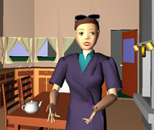
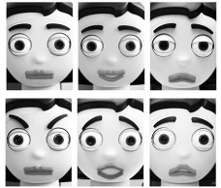
What a real SDS may want
Intuitive, affordable spoken dialogue system
  Embodied Conversational Agents [Cassel et al., 2003]
    Human-to-human interaction experiments
Affective Computing on MIT
  “Sociable and empathetic expression tailored to the user’s mental state is preferred and trustable”
“User-Centered Design” by Don Normal (1988)
  “Attractive things work better”

Slide 12
Our Motivation
An “affection” should be coupled with technology
  Not only a nice-looking agent
  Better intelligence, better representation
Let a designer do the job, apart from technology!
A clear interface design of SDS is required
  A design requirement from the technical view
  A technology that a designer can fully utilize

Slide 13


Slide 14
MMDAgent
Combining ASR, TTS with 3D-CG Rendering
  Embodied Conversational Agent
  Human-Agent Interaction
  Voice-enabled interaction
Features
  All-in-one dialogue engine: ASR/TTS/DM/CG/…
  Simple message-based architecture
    Easy to add extra engines/sensors/etc.. by plugins
  Open-source, open format, cross platform
    Runs on Windows/Mac/Linux/Android
  Modern CG rendering, tightly integrated with DM

Slide 15
MMD = MikuMikuDance
3D-CG software
  Cartoon-based rendering
  Any 3-D Object can be modeled
Has a big CGM scene in Japan
  With singing-voice synthesis
  Thousands of models, motions, still growing
Rich expression capability
  Animation / movement / morphing
  Physics simulation
Free tools

Slide 16
System architecture
Sensor I/O
Display (OpenGL)
Audio I/O
Image recog.
Person finder
Key Events
Agent Module
Speech Recognition
(Julius)
Speech Synthesis
(Open JTalk)
Events
Commands
Global Message Queue
Events
Commands
Information
Extractor
Dialog Manager
Audio Player
Window Controller
Key Event Generator
FST scenario

Slide 17
Dialogue FST
Input: messages from each module (event, status, etc)
Output: messages to modules (command etc)
#### format: [from_state] [to_state] [event] [command]
#Initialization: add agent and set waiting motion as base motion
0 | 1 | <eps> | MODEL_ADD|mei|mei.pmd
1 | 2 | <eps> | MOTION_ADD|mei|base|wait.vmd|FULL|LOOP
#Sample pattern 1: Listening
2 | 2 | RECOG_EVENT_START | MOTION_ADD|mei|listen|listen.vmd|PART|ONCE
#Sample pattern 2: Greeting
2 | 3 | RECOG_EVENT_STOP|hello | MOTION_ADD|mei|greet|greet.vmd|PART|ONCE
3 | 4 | <eps> | MOTION_ADD|mei|smile|smile.vmd|PART|LOOP
4 | 5 | <eps> | SYNTH_START|mei|normal|Hi
5 | 2 | SYNTH_EVENT_STOP|mei|normal | MOTION_DELETE|mei|smile

Slide 18
Open Format
Contents | Format | Related tools
3-D Object | .pmd | MikuMikuDance* Blender, 3ds Max, etc.
Motion | .vmd | MikuMikuDance*
Acoustic model for ASR | HTK ASCII / Julius | HTK
Language model for ASR | ARPA standard format / Julius | SRILM etc.
Dialog Scenario | FST | OpenFST
Acoustic model for SS | HTS | HTS

Slide 19
Open Source
Module | Component | License type
3-D rendering | BulletPhysics | zlib license
 | GLee | BSD license
 | GLFW | zlib license
 | JPEG | BSD-style license
 | libpng | zlib license
 | zlib | zlib license
Speech recognition | CSRC Dictionary | BSD-style license
 | Julius | BSD-style license
 | PortAudio | BSD-style license
Speech synthesis | hts_engine API | BSD license
 | MeCab | BSD license
 | Naist Japanese Dictionary | BSD license
 | Open JTalk | BSD license

Slide 20
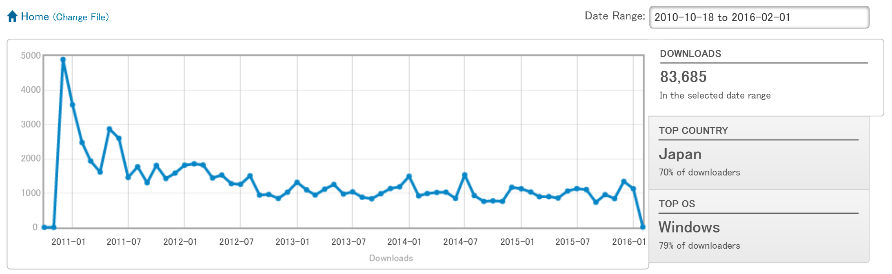
Statistics
83,685 Downloads since 2010/18

Slide 21
History

Slide 22
History
1.0 (2010)
1.1, 1.2 (2011)
1.3 (2012)
  Extended FST messages
1.4 (2013)
  Optimized CG performance
  Support for Android
1.5 (2014)
  Local variables in DM-FST
1.6 (2015)
  Regular expression in DM-FST
  UTF-8
TTS / ASR updates
Library updates
Performance up
Compatibility fix
Bug fixes
Cross-platform fixes
+

Slide 23
Current Status

Slide 24
Version 1.6 (2015/12)
Internationalization
UTF-8 encoding in all text files
Text display
Font rendering (now internal)
Full UTF-8 support
Enhanced FST capability
Regular expression
Installer, packager
Windows installer
Zip loader for dialogue contents packaging (.mmda)
Removal of Japanese SJIS dep.
New support: MacOS / Linux / Android
OS-dependent file path encoding handling fix
Fixed Variable handling

Slide 25
Regexp and variables in FST
0 10 <eps> <eps> ${place}=Nagoya
# “Whether,in,Nagoya”
10 10 RECOG_EVENT_STOP|Wether,${place} MESSAGE|3
# “Tokyo,Station” -> capture station name to variable
10 10 @RECOG_EVENT_STOP\|.*?([^,]*),?[Ss]tation.*@ <eps> ${station}=${1}
# capture all recognition result
10 10 @RECOG_EVENT_STOP\|(.*)@ MESSAGE|99|${1} ${recogstr}=${1}
Variables
Set at #5
Refer at #3, #4
Names: [A-Za-z0-9_]+
Regular expressions
Embrace #3 by “@” to
activate RE matching
FULL match to the whole message
Matched substrings are set to ${1}, ${2}, …
Powered by Google RE2 Library

Slide 26
Content packaging
Pack a dialogue content to a single file
  .mdf, .fst, 3D-model, motion, Voice, …
Pack a content:
  Zip all the required files to a “.zip” file
  Change the suffix from “.zip” to “.mmda”
Usage
  Execute by “MMDAgent foobar.mmda” or double tap!
    Extract files into a temporary folder
    Then, execute the “.mdf” file in the top directory
Note: unzip will reveal its contents again

Slide 27
Platforms (1)
Windows
  Recent Intel mobile CPU/GPU is sufficient
  Gaming GPU can handle much complex models
Linux (Ubuntu)
  Vender-supplied graphic driver is recommended
  Runs perfectly on VirtualBox-5.x guest
Tested on Windows 7/8/8.1/10 / Visual Studio 2010/2013/2015
Just open solution file and build
Tested on Ubuntu-14.04
% apt-get install build-essential libc6-dev mesa-common-dev \
libglu1-mesa-dev libxrandr-dev libasound2-dev
% make linux

Slide 28
Platforms (2)
Mac
Android
  > 4.0 (5.0 for mp3 audio in 1.6)
  Runs good on Nexus 7 (2013).
iOS (in progress)
Tested on OS X 10.11.2 / XCode 7.2
% make cocoa
Android SDK, Android NDK as core for build
Eclipse + ADT or AndroidStudio for integrated build / test interface

Slide 29
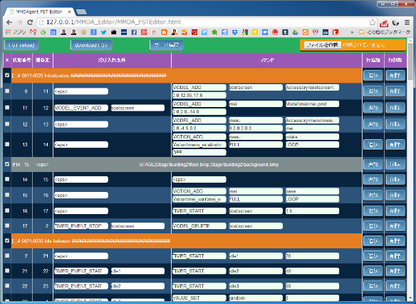
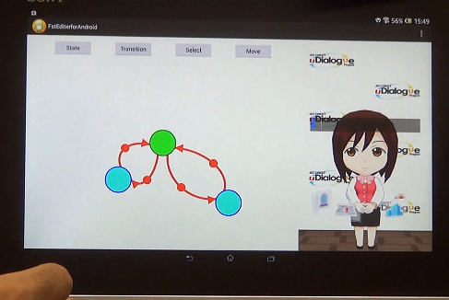
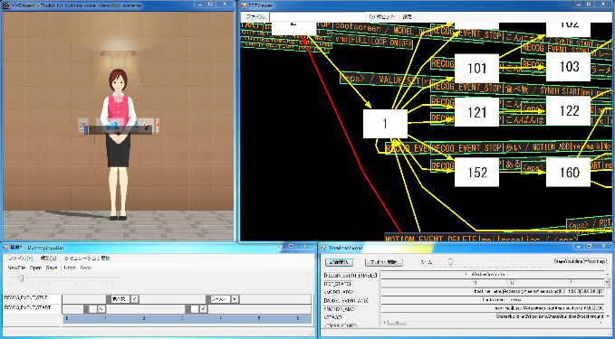
FST build tools
FST Editor
  Web browser based
  For crowdsourcing
Touch-based Editor
  Android app
  Intuitive editing for novice
Interaction Builder
  FST view / Debug / Profile
  For creator

Slide 30

Copyright 2016 Nagoya Institute of Technology

